Slide 1
Thermal Image Pin Recognition
Eric Romero & Justin Guerra
COSC 4590
Digital Image Processing and Computer Vision Fall 2015
Dr. Maryam Rahnemoonfar

Slide 2
Overview
What we designed
How we designed it
Our contributions
Dataset
Results
conclusion

Slide 3
What we designed
A thermal recognition software designed specifically to identify Personal Identification Numbers (PIN)
Pros:
An innovative security software
A tool to help increase security
A tool to help reduce data theft
A potential tool for investigations
Cons:
Malicious users
Identity theft
Weakens access points that use PIN pads

Slide 4
How we designed it…

Slide 5


Slide 6



How we designed it
Science fiction + Mozzie = The idea
Research lead to a document
Heat of the Moment: Characterizing the Efficacy of Thermal Camera-Based Attacks
Tools used:
OpenCV
FLIR C2
git
Approach
Used Mat objects
Scalar() function
Many more…

Slide 7

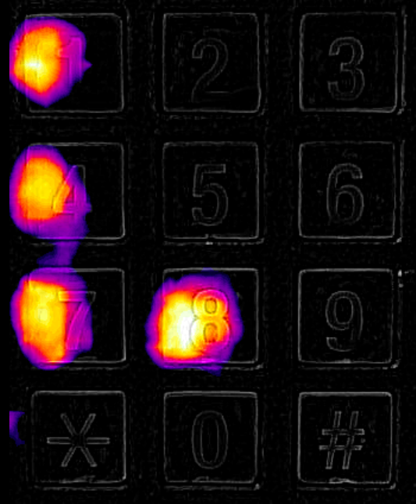
Before PIN is entered
After PIN is entered

Slide 8
How we Designed it
Research
Max
With the max method, each ROI was rep- resented by the maximum temperature recorded within the region. We found that, while this did pull out high temperatures caused by user warmth, it also fell prey to higher noise in blank regions.
Mean
With the mean method, each ROI was represented as the arithmetic mean of its temperatures. This method did a far better job than the max method of smoothing out noise; still, we observed that old or light keypresses sometimes provided a very small movement in the mean. Overall, however, this method achieved the best performance out of the three.
Binarize
Finally, for the binarize method, we com- pared each pixel against its counterpart in the cal- ibration frame. If its temperature increased, we treated it as a 1; otherwise, as a 0. By then ap- plying the mean method to the binarized image, we can gain a measure of how much of the ROI has in- creased in temperature.

Slide 9
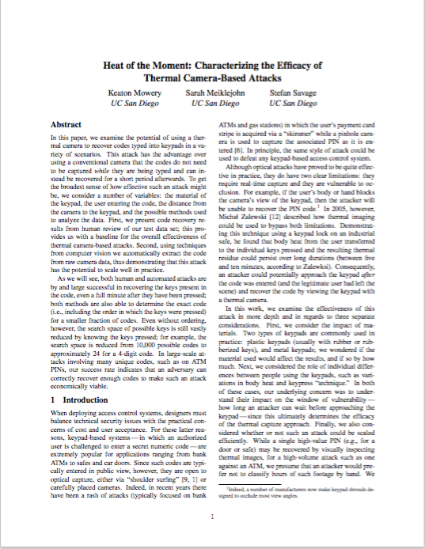
Our contributions – Eric & Justin
Problems:
How do we find the ROI?
Eric identified a method that would
allow us to split the image.
How to identify presses within
each ROI?
Justin found an OpenCV method that
will allow us to work with
a specific channel.
Approach:
Can this be done completely autonomously? (ongoing…)
- Justin
Identify a press (complete…)
- Eric

Slide 10
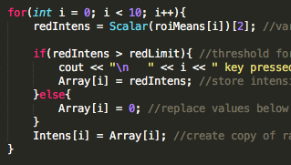
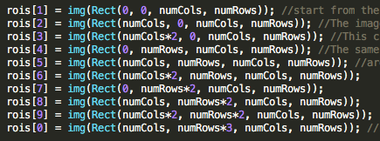
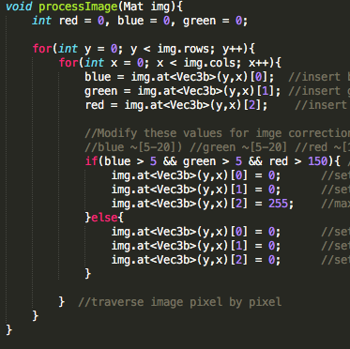
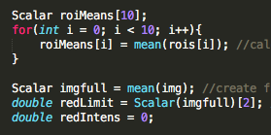

contributions – Eric (complete)
Returning ROIs with the highest mean values
Create ROI regions within the image
Calculate the mean values of ROIs
Sort the mean values

Slide 11

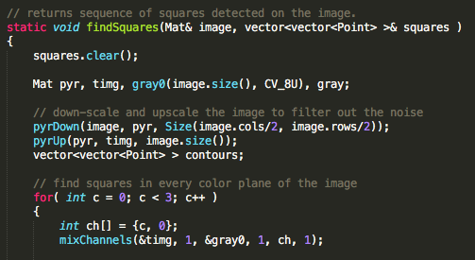

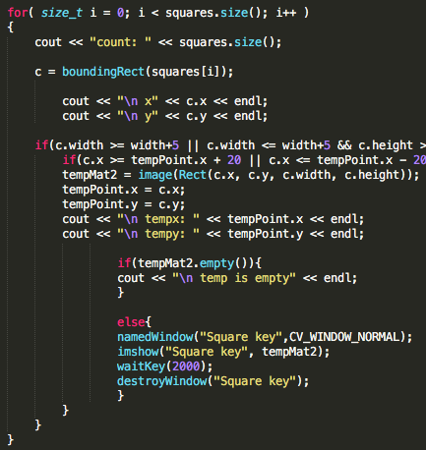
Contribution – Justin (ongoing)
User visually identifies the key
Trying to filter the keys autonomously
Cited: Nash. “Detecting shapes in an image” opencv-code.com
Dec. 17 2012. 10. 20. 2015 was accessed.
http://www.easybib.com/reference/guide/mla/website

Slide 12
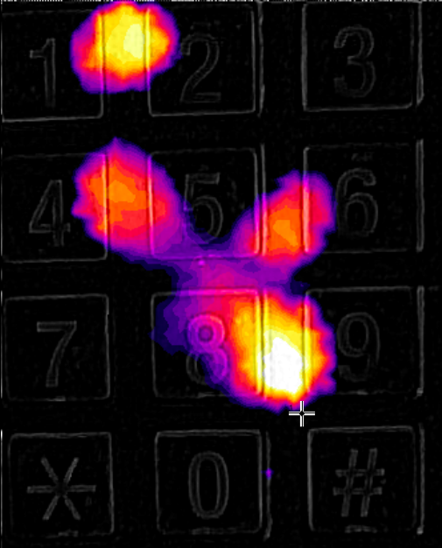
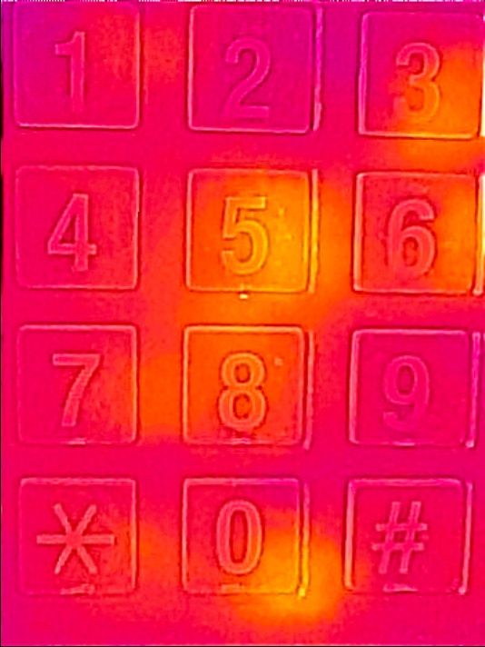
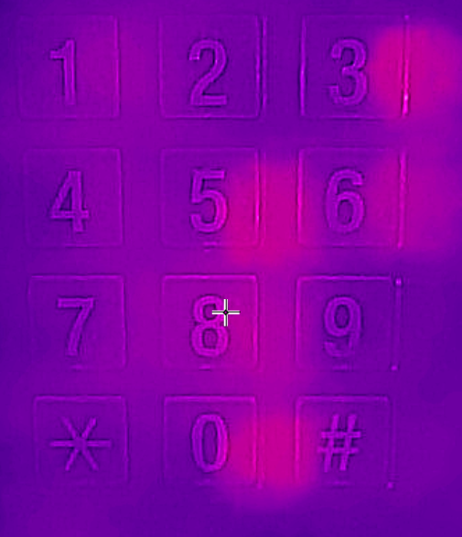
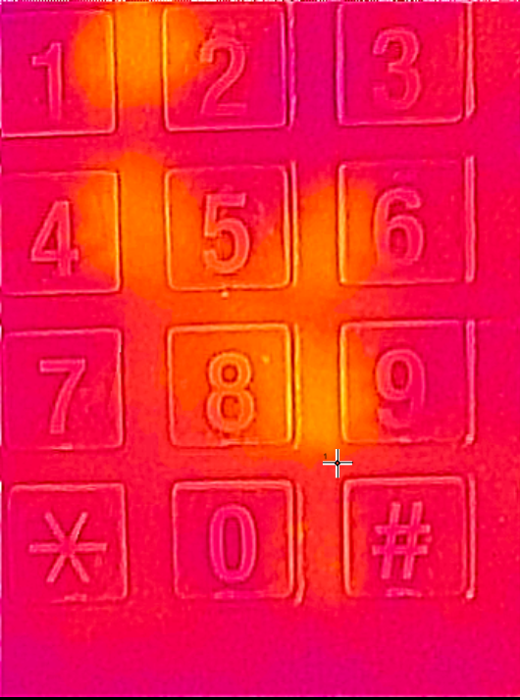
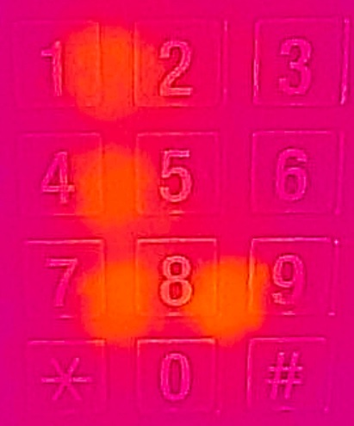
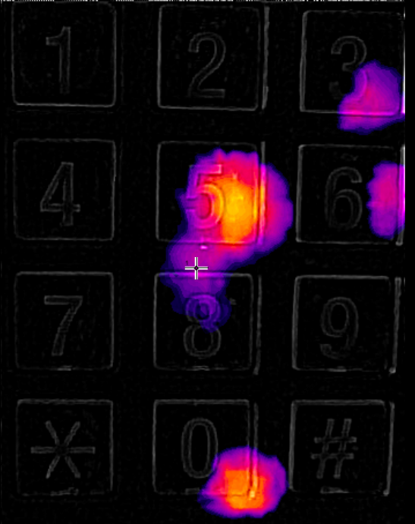
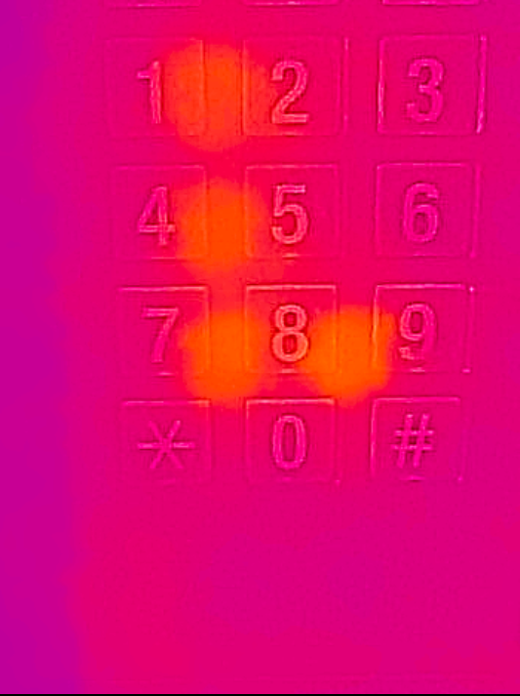
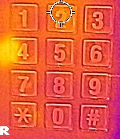
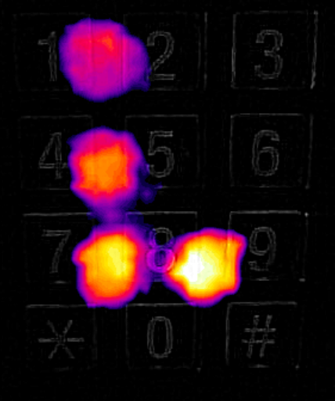

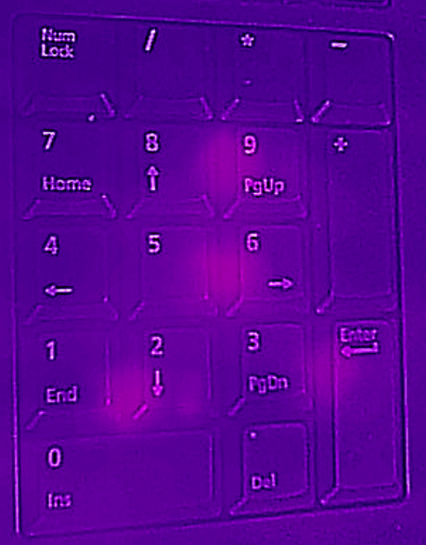
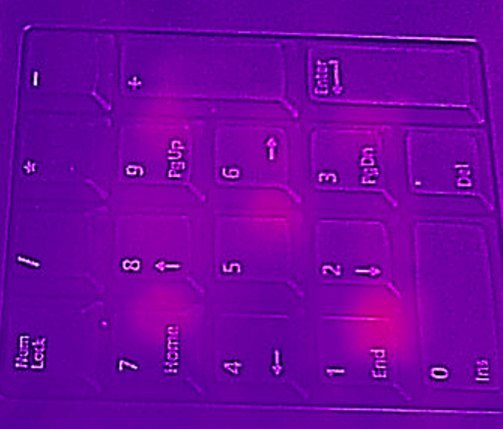
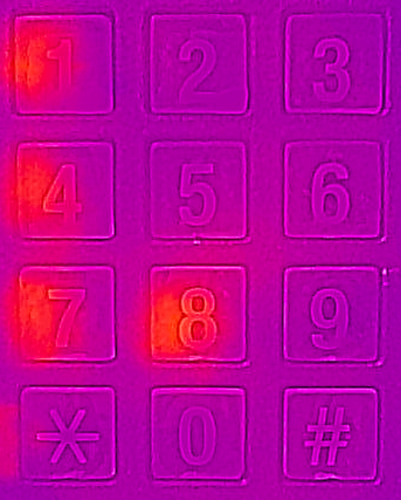

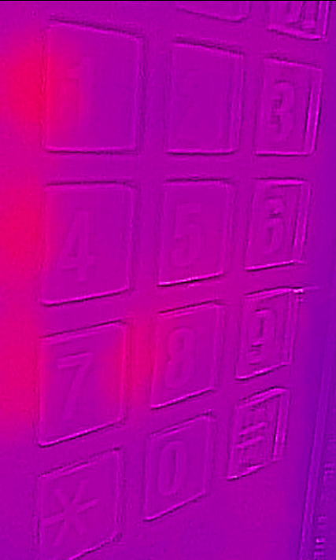
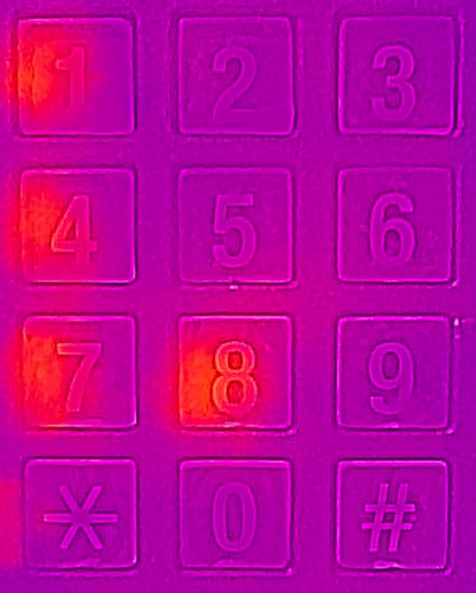
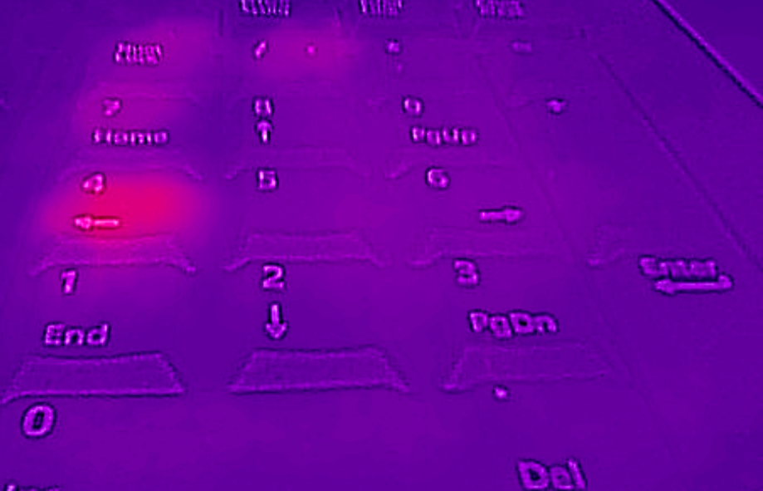

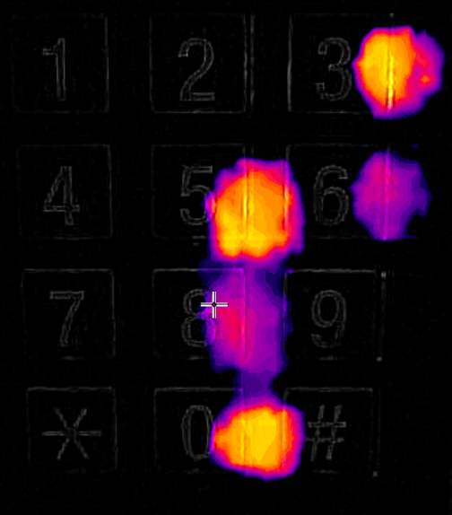
Dataset

Slide 13
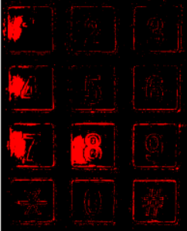
Results
Raw
Processed

Slide 14
Conclusion
How to identify a press?
Find R channel average for full image
Parse the image into 10 ROIs
Find R channel average for each ROI
Collect top four ROIs with an R
channel average higher than the full image
Identify all possible permutations of the 4 digit PIN
Can this be done a autonomously?
Autonomous key identification is not accurate
Other objects that are not keys are identified
How do we find the ROI?
Divide the image into nine sections

